Slide 1
RETAIL ANALYSIS EXTRACT HUB
SUBMITTED BY
VANKADARU LAKSHMI RISHMITHA

Slide 2
ABSTRACT
The Retail Analysis Extract Hub is a project that helps analyze Amazon's sales data using Python and SQL. The goal is to understand how well products are selling, what customers are buying, and how sales change over time.
The system takes sales data from a file called amazon sales 2025 from kaggle, and processes it to show useful information like:
Total sales by category
Top-selling products
Total sales by status
Sales by location
Sales by payment method

Slide 3
STEPS PERFORMED
Extracted the amazon sales data from Kaggle
Cleaned and preprocessed the data using python and analyzed that data
Loaded the data into mysql workbench by creating a database
Established a connection between MySQL workbench and python using mySQL connector
Performed all the required operations and extracted data from that queries
At last performed visualizations on the extracted output.

Slide 4
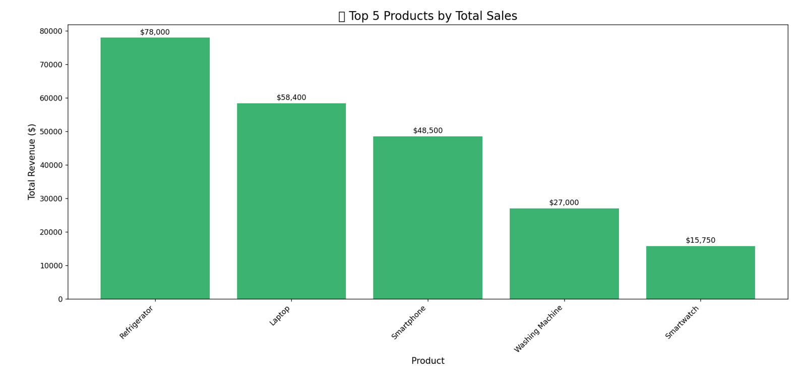
VISUALIZATIONS

Slide 5
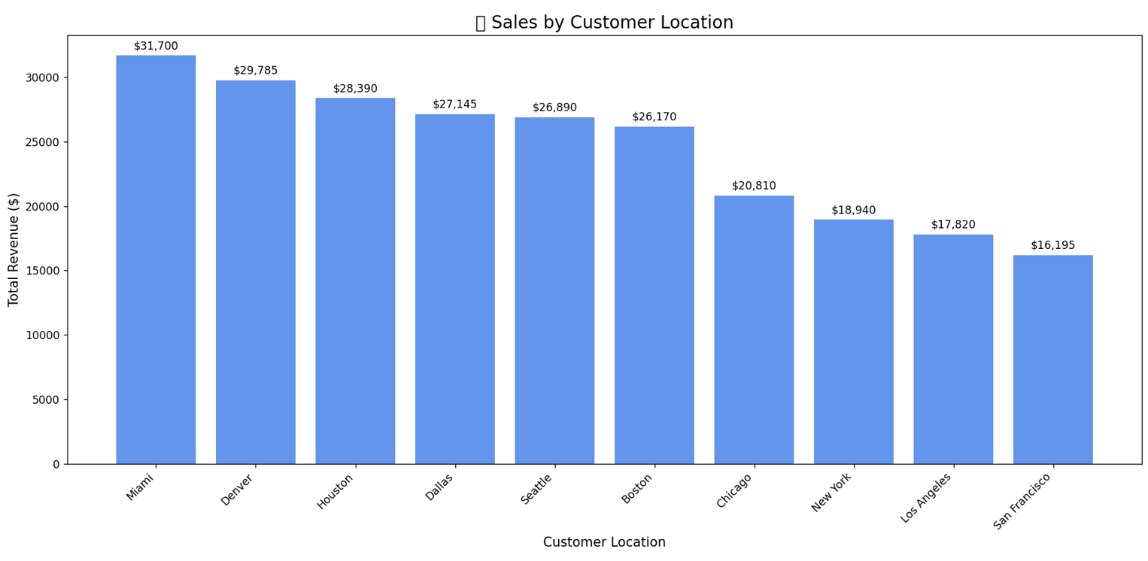

Slide 6
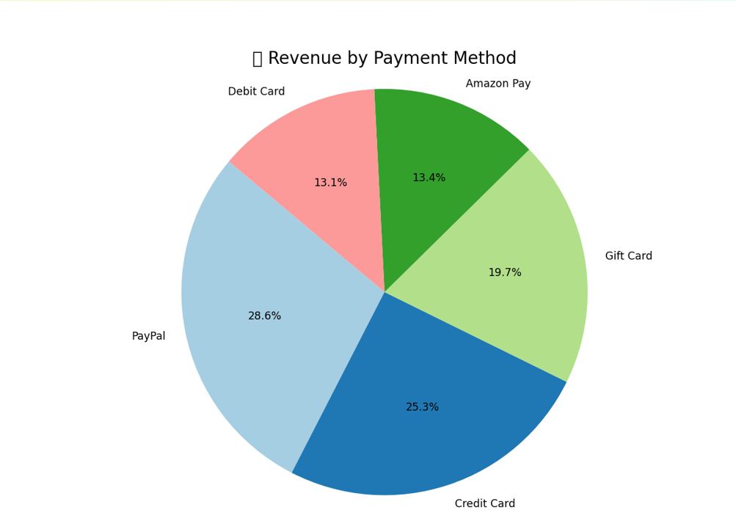
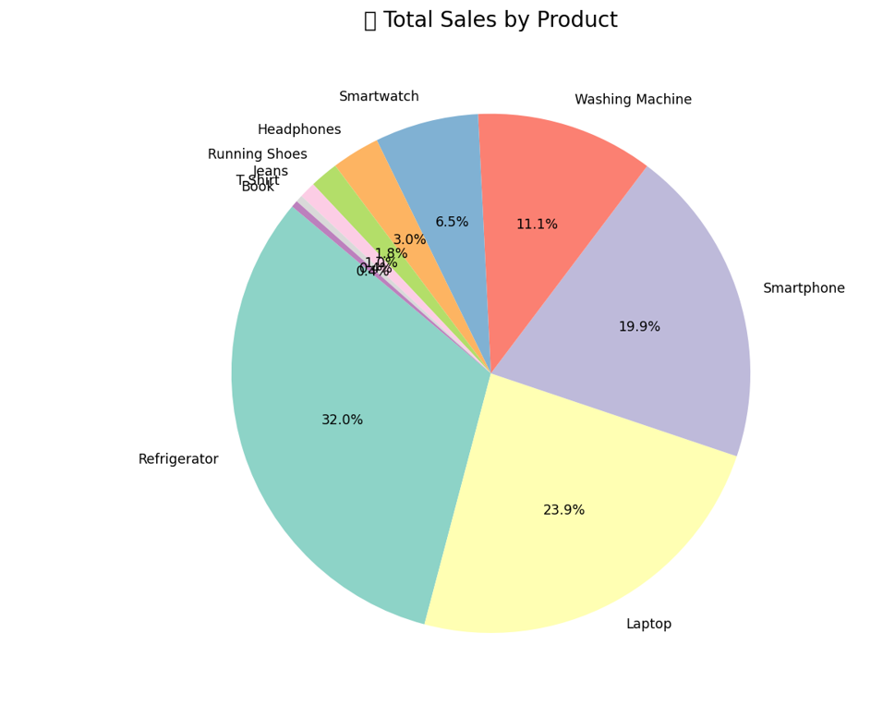

Slide 7
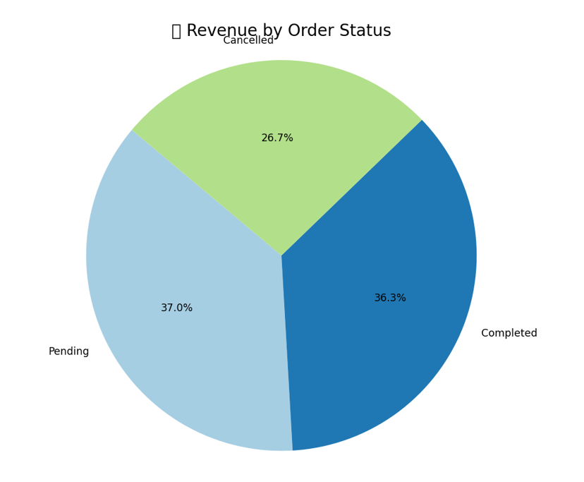
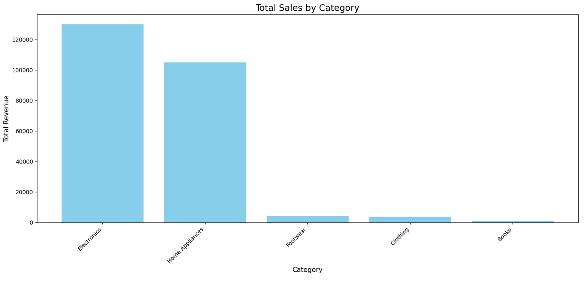

Slide 8
ADVANTAGES
Centralized Data Access
Combines sales, customer, product, and inventory data in one place.
Eliminates the need to manually gather data from different sources like POS systems, e-commerce platforms, or supplier feeds.
Better Business Decisions
Helps identify sales trends, top-performing products, customer behavior, etc.
Assists in forecasting demand, managing inventory, and running targeted marketing.

Slide 9
THANK YOU!!!!

